Slide 1
Java Basics
AJAX briefing, JSON handling, ExtJS MVC & more…
Java workshop training, August,2017.
Dr. Kishore Biswas (Forrest/柯修)
PhD. Artificial Intelligence—Natural Language Processing.
CanWay IT Training ®.

Slide 2
1.AJAX briefing
2.JSON handling
3.ExtJS MVC
4.ExtJS Component System
5.ExtJS Layout System
6.How to use ExtJS Doc

Slide 3
JavaScript
Inserted into HTML pages
Processed client-side (by the browser)
HTML elements dynamically changed

Slide 4
JavaScript Variables
Variables are dynamic, weakly typed:
var x = ‘Hello’; //x is a string
var y = 2011; //y is an integer

Slide 5
JavaScript Functions
Functions do not require variable types
function firstFunction(a, b){
}
Or a return type
function doubleMyNumber(a){
return a*2;
}

Slide 6
Basic JavaScript Outputs
To display a message box:
alert(‘Hello’);
Or you could manipulate an HTML control
<input type="text" id="text1">
text1.value = "Hello";

Slide 7
JavaScript Events
HTML elements call JavaScript events
For example, the body element has onload
<script>
function init(){
alert(“Page Loaded”); }
</script>
<body onload=“init()”></body>

Slide 8
JavaScript Events
Many elements have onclick
<script>
function linkClicked(){
alert(“Clicked”); }
</script>
<body><a onclick=“linkClicked()”>Click</a>
</body>

Slide 9
Calling Methods from URLs
Note that:
<a onclick=“linkClicked()”>Click</a>
Could also be written as:
<a href=“javascript:linkClicked()”>Click</a>

Slide 10
Control Structures
Most control structures are similar to Java
var a = new Array(“first”, “second”, “third”);
var i = 0;
for (i = 0; i < a.length; i++){
alert(a[i]);
}
while(i > 0){ alert(i); i--;
}

Slide 11
Document Object Model
JavaScript allows you to navigate between the elements of a page using the DOM
For example:
<input type=“text” id=“mytxt”>Hello</input>
var mytxt = document.getElementById(‘mytxt’);
mytxt.value = “Hello ” + user;

Slide 12
Browser implementations
As with HTML/CSS displays some browsers are inconsistent
If something works in Firefox, it might not work in Internet Explorer
The best way of ensuring browser compatibility is to use a JavaScript framework, such as jQuery

Slide 13
jQuery Example
The previous example
document.getElementById(‘mytxt’).value = “Hello ” + user;
Could be expressed in jQuery as
$(“#mytxt”).val(“Hello ” + user);

Slide 14
Cookies
The document.cookie property allows variable values to be stored in a ‘cookie’
Cookie file stored on the client’s computer
The website can read this file next time the user visits the site
For security reasons, cookies can only be read by the domain that stored it.

Slide 15
Cookies: Writing
document.cookie needs to contain keys and values
document.cookie is a string:
document.cookie = “name=sam;”
You also need an expiration date, or it will get destroyed when browser is closed
document.cookie = “name=sam; expires=Fri, 18 Feb 2011 12:00:00 UTC;”

Slide 16
Cookies: Writing
Multiple key/values can be specified by assigning to the variable twice:
document.cookie = "name=sam;expires=Fri, 18 Feb 2011 12:00:00 UTC;";
document.cookie = "favcolour=orange;expires=Fri, 18 Feb 2011 12:00:00 UTC;";
To delete a cookie, assign an expiry date in the past

Slide 17
Cookies: Reading
Access document.cookie as a string “name=sam; favcolour=orange”
var c = document.cookie.split(';');
for(var i = 0; i < c.length; i++){
var key = c[i].split('=')[0];
var value = c[i].split('=')[1];
if(key == 'name')
alert('Hello again ' + value);
}

Slide 18
AJAX
Interacting with web servers using AJAX

Slide 19
AJAX
Allows JS pages to retrieve information without reloading the whole page
Uses
Form validation
Auto Complete
Title -> Detail views
Refreshing (e.g. Email Inbox, RSS Feeds)

Slide 20
Introduction to XML
XML allows information to be structured
Structure is similar to XML, with elements (e.g. <p>) and attributes (e.g. id="box1")
You can define your own type of XML, with your own tags
Common uses of XML include:
RSS | XHTML
Office Open XML | SOAP

Slide 21
XML Syntax
XML must be well formed.
For instance: <p>Hello <b>World</p> is valid HTML, but invalid XHTML – tags must be closed:
<p>Hello <b>World</b></p>
Special Characters must also be defined, and escaped correctly (e.g. &amp; to &)

Slide 22
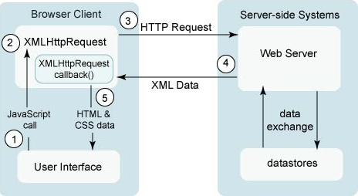
AJAX Architecture

Slide 23
AJAX Libraries
Browsers implement AJAX differently
Easiest to use a library
Our examples use jQuery, which caters for all browsers, making it easier to write compatible code

Slide 24
jQuery AJAX
jQuery functions can be called using
$(sel).load(url, [data], [callbackfunction]);
Where sel selects the element in the HTML page
For instance $("#text") selects the HTML element which has id="text"
$("#text").load("test.php"); puts the result of test.php into the text element

Slide 25
jQuery AJAX
You can also specify parameters such as
$("#text").load("test.php", {a: 4, b: 2});
is equivalent to loading "test.php?a=4&b=2"
For security reasons, the page you load needs to be on the same domain
You can also use $.get(...) or $.post(...)
These functions take a callback function

Slide 26
jQuery AJAX
The previous example could be written using $.get:
$.get("test.php", {a: 4, b: 2}, function(data){
$("#text").html(data);
});
This allows you to process the data in the function, without immediately displaying it

Slide 27
JavaScript Frameworks
jQuery: http://jquery.com/
Ext-Core: www.sencha.com/products/extjs
Prototype: http://prototypejs.org/
Dojo: http://dojotoolkit.org/documentation
And there are many more...
Choose one that best fits your needs

Slide 28
Conclusion
JavaScript can create interactive, dynamic pages
Cookies store variables between sessions
AJAX used for interactively loading elements of page from other scripts

Slide 30
Facts
AJAX is a type of programming made popular in 2005 by Google (with Google Suggest).
AJAX is not a new programming language, but a new way to use existing technologies.
With AJAX you can create better, faster, and more user-friendly web applications.

Slide 31
AJAX is based on the following web technologies:
Java Script
XML
HTML
CSS

Slide 32
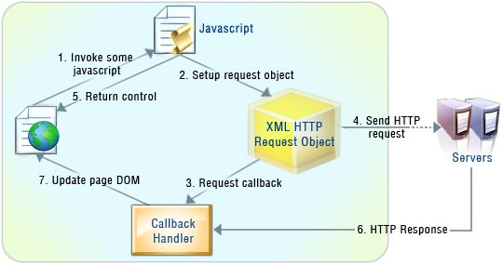

Slide 33
Building an AJAX Application
<html>
<body>
<form name="myForm">
Name: <input type="text" name="username" />
Time: <input type="text" name="time" />
</form>
</body>
</html>

Slide 34
Building an AJAX Application (Contd..)
<script type="text/ javascript"> function ajaxFunction() { var xmlHttp;
try { // Firefox, Opera 8.0+, Safari xmlHttp=new XMLHttpRequest(); }
catch (e) { // Internet Explorer try { xmlHttp=new ActiveXObject("Msxml2.XMLHTTP"); }
catch (e) { try { xmlHttp=new ActiveXObject("Microsoft.XMLHTTP"); }
catch (e) { alert("Your browser does not support AJAX!"); return false; }
}
}
} </script>

Slide 35
Building an AJAX Application (Contd..)
The readyState Property
xmlHttp.onreadystatechange=function() {
if( xmlHttp.readyState==4 )
{
document.myForm.time.value= xmlHttp.responseText;
}
}
State | Description
0 | Request not initialised
1 | Request has been set up
2 | Request has been sent
3 | Request is in process
4 | Request is complete

Slide 36
Building an AJAX Application (Contd..)
Sending a Request to the Server
xmlHttp.open("GET","time.asp",true);
xmlHttp.send(null);
Executing the AJAX function
<form name="myForm">
Name: <input type="text" onkeyup="ajaxFunction();" name="username" />
Time: <input type="text" name="time" />
</form>

Slide 37
Examples
http://maps.google.com/
http://www.flickr.com/
http://www.google.com/ig
http://www.kayak.com/
http://www.orkut.com/Main#Home.aspx

Slide 38
AJAX Frameworks
Ajax frameworks support Ajax technologies to build dynamic, client-side web sites.
The goal of the Ajax framework is to function as a communication layer between user and server.
Allow you to develop AJAX application much like a desktop GUI, by composing reusable widgets and attaching behavior and data to them.

Slide 39
Types of AJAX Frameworks
Direct object frameworks - Smaller – Website Development
Ajax component frameworks - Larger – Web Applications
Server driven Ajax frameworks - Server Side Developers

Slide 40
AJAX Component Framework
Use pre-made components to generate and apply HTML.
More rapid development and require less control .
Component frameworks provide customized APIs, allow dynamic program control based on user input, and create new components based on existing ones.

Slide 41
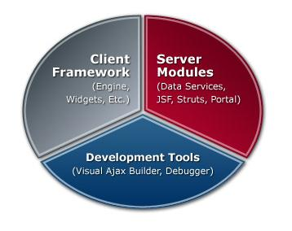
AJAX enabled JSF Components and Framework
Backbase Enterprise Ajax is the leading Ajax framework.

Slide 42
Backbase Ajax Development Tools
Visual Ajax Builder
Debugger (client-side)
Code Samples and Starter Kits
Extensive Documentation

Slide 43
Visual Ajax Builder
Code named Telamon.
It is the only WYSIWYG Integrated Development Environment (IDE) specifically designed for Rapid Application Development of Ajax based applications.
It uniquely allows you to make changes to your code while browsing through the pages.

Slide 44
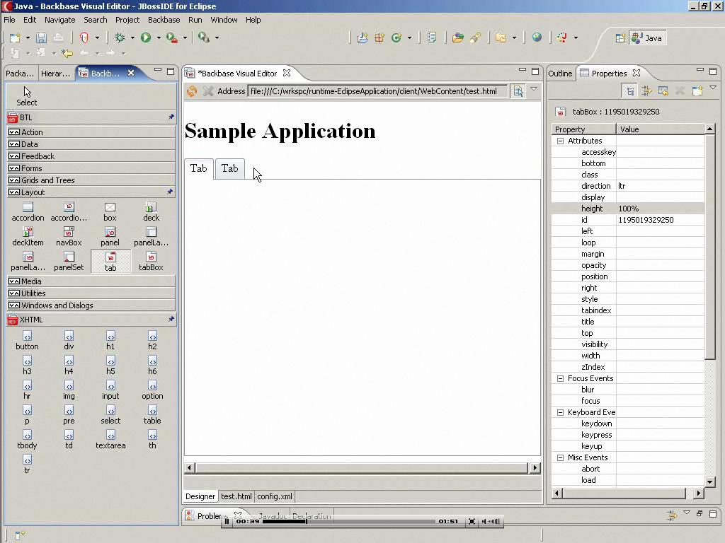

Slide 45
Code Samples and Starter Kits
The hundreds of code samples in the Backbase Ajax Explorer can be used to learn the technology and quickly assemble feature-rich Ajax applications.
http://demo.backbase.com/explorer/#|examples/welcome.xml

Slide 46
Advantages of AJAX
Ajax’s primary contribution to web pages is user-experience improvement.
Decreases User Delay
Decrease in Bandwidth
Complex User Interface Controls and effects

Slide 47
Disadvantages
Dynamically created pages do not register themselves with the browser's history engine.
Any user whose browser does not support Ajax or JavaScript, or simply has JavaScript disabled, will not be able to use its functionality.
Lacks Security
Even though Ajax should typically speed up your web page, it ultimately is dependent upon the same hardware as other web technologies and thus is subject to the same problems as normal web pages.

Slide 48
2.JSON handling

Slide 49
What is JSON
JavaScript Object Notation
Used to format data
Commonly used in Web as a vehicle to describe data being sent between systems

Slide 50
JSON example
“JSON” stands for “JavaScript Object Notation”
Despite the name, JSON is a (mostly) language-independent way of specifying objects as name-value pairs
Example (http://secretgeek.net/json_3mins.asp):
{"skillz": { "web":[ { "name": "html", "years": 5 }, { "name": "css", "years": 3 }] "database":[ { "name": "sql", "years": 7 }] }}

Slide 51
JSON syntax
An object is an unordered set of name/value pairs
The pairs are enclosed within braces, { }
There is a colon between the name and the value
Pairs are separated by commas
Example: { "name": "html", "years": 5 }
An array is an ordered collection of values
The values are enclosed within brackets, [ ]
Values are separated by commas
Example: [ "html", ”xml", "css" ]

Slide 52
JSON syntax
A value can be: A string, a number, true, false, null, an object, or an array
Values can be nested
Strings are enclosed in double quotes, and can contain the usual assortment of escaped characters
Numbers have the usual C/C++/Java syntax, including exponential (E) notation
All numbers are decimal--no octal or hexadecimal
Whitespace can be used between any pair of tokens

Slide 53
How to turn JSON into JavaScript object –eval(*)
The JavaScript eval(string) method compiles and executes the given string
The string can be an expression, a statement, or a sequence of statements
Expressions can include variables and object properties
eval returns the value of the last expression evaluated
When applied to JSON, eval returns the described object

Slide 54
JSON and—methods?
In addition to instance variables, objects typically have methods
There is nothing in the JSON specification about methods
However, a method can be represented as a string, and (when received by the client) evaluated with eval
Obviously, this breaks language-independence
Also, JavaScript is rarely used on the server side

Slide 55
Comparison of JSON and XML
Similarities:
Both are human readable
Both have very simple syntax
Both are hierarchical
Both are language independent
Both can be used by Ajax
Both supported in APIs of many programming languages
Differences:
Syntax is different
JSON is less verbose
JSON can be parsed by JavaScript’s eval method
JSON includes arrays
Names in JSON must not be JavaScript reserved words
XML can be validated

Slide 56
JSON in AJAX
JSON can be used in AJAX as follows:
Include it in HTML directly
<html>... <script> var data = JSONdata; </script>... </html>
JSON is used with XMLHttpRequest and can be converted into a JavaScript structure
responseData = eval('(' + responseText + ')');
We have not yet spoken about AJAX --- revisit this again after you have learned about AJAX

Slide 57
Why is JSON better suited for AJAX?
JSON is widely used in AJAX. The X in AJAX stands for XML.
E.g.
{
"fullname": "Swati Kumar",
"org": "Columbia",
}
<?xml version='1.0‘ encoding='UTF-8'?>
<element>
<fullname>Swati Kumar</fullname>
<org>Columbia</org>
</element>

Slide 58
JSON response at client side is:
var name = eval('(' + req.responseText + ')').fullname.value;
To access a composite element
eval('(' + req.responseText + ')').xyz.abc.value;
Thus, any level deep elements can be easily accessed.

Slide 59
XML and JavaScript
XML response at client side is:
var root = req.responseXML;
var name = root.getElementsByTagName(‘fullname’);
To access a composite element
root.getElementsByTagName(‘xyz’)[0].firstChild
To access deeper levels we need more overhead.
Reduced extensibility in XML

Slide 60
YAML – another option?
YAML can be taken as an acronym for either
Yet Another Markup Language
YAML Ain’t Markup Language
Like JSON, the purpose of YAML is to represent typical data types in human-readable notation
YAML is (almost) a superset of JSON, with many more capabilities (lists, casting, etc.)
Except: YAML doesn’t handle escaped Unicode characters
Consequently, JSON can be parsed by YAML parsers
When JSON isn’t enough, consider YAML

Slide 61
JSON and Java
How to parse JSON in Java

Slide 62
Mapping between JSON and Java entities
JSON | Java
string | java.lang.String
number | java.lang.Number
true|false | java.lang.Boolean
null | null
array | java.util.List
object | java.util.Map
JSON.simple maps entities from the left side to the right side while decoding or parsing, and maps entities from the right to the left while encoding.
On decoding, the default concrete class of java.util.List isorg.json.simple.JSONArray and the default concrete class of java.util.Map isorg.json.simple.JSONObject.

Slide 63
JSON reading in Java example
http://www.tutorialspoint.com/json/json_java_example.htm

Slide 64
There is an interface called JSONParser in javax.json.stream you can implement
javax.json.stream
Interface JsonParser

Slide 65
3.ExtJS MVC

Slide 66
JavaScript Testing
For rich web client applications

Slide 67
A few of the features of rich web clients
Rich, desktop-like capabilities
Generate their own HTML
Ajax – Asynchronous Javascript and XML

Slide 68
The Need for Testing
Controller, as in MVC, is in the client (“Processes and responds to events (typically user actions) and may indirectly invoke changes on the model.” - Wikipedia)
View- Events, validation, display logic, error handling is there too.
“I entered FOO and I got BAR back” as a bug description doesn’t leave you with much to go on.
Whack-A-Mole bug fixing results without good test tools.
End to end testing is not efficient.

Slide 69
UI Testing Frameworks Vary
Run exclusively in browsers
Simulate browsers
Unit Test Javascript (in the browser)

Slide 70
The Tools
Unit testing – JSUnit, Envjs, HtmlUnit
Integration/Component Testing – HtmlUnit
Functional Testing - Selenium

Slide 71
Jsunit
Started in 2001
Write JavaScript tests embedded in HTML.
Provides a TestRunner to run in a browser.
Comes with a server and ant tasks

Slide 72
Example
// Test the date stuff
function testDateGetYear() {
var date = new Date();
debug("getYear() gives value ", date.getYear());
debug("getFullYear() gives value ", date.getFullYear());
assertNotEquals("ECMAScript error", date.getYear(), date.getFullYear());
}

Slide 73
EnvJs
Goal is to deliver a DOM implementation in pure JavaScript
Can be executed in Rhino
Enables headless testing
Easy to execute in Junit
Still in development – pre alpha release

Slide 74
Example Bootstrap
load('envjs/dist/env.js');
window.location='test/com/objectpartners/envjs/test.html';
document = window.location;
var extDir = 'WebContent/js/ext-2.2/';
load(extDir + 'adapter/jquery/jquery.js');
load('test/com/objectpartners/envjs/jquery-plugins.js');
load(extDir + 'adapter/jquery/ext-jquery-adapter.js');
load(extDir + 'ext-all-debug.js');

Slide 75
Example Test
load('src/com/objectpartners/testing/envjs/Validator.js');
var validators = new validators.field();
assertNotNull(validators);
assertTrue(validators.dateAfterValidator('10/10/2010'));
assertFalse(validators.dateAfterValidator('10/10/2001'));
assertFalse(validators.dateAfterValidator(new Date()));
assertTrue(validators.creditCardNumberValidator('4539391999535458'));
assertFalse(validators.creditCardNumberValidator('something'));

Slide 76
HtmlUnit
Latest January release provided best Javascript Library support for headless testing yet.
Addresses some cross-browser compatibility
Easy to integrate into Junit
Not the best JavaScript->Java API support
Well suited for Integration testing

Slide 77
//Make sure the button is there, and if it is, click it
HtmlButton button = (HtmlButton) htmlPage.getFirstByXPath("//*[contains(@class,'x-btn-text start')]");
assertNotNull(button);
button.click();
// Get the start menu, and make sure the menu items are there
HtmlDivision startMenuDiv = (HtmlDivision) htmlPage.getFirstByXPath("//*[contains(@class,'x-panel x-border-panel ux-start-menu-apps-panel')]");
assertNotNull(startMenuDiv);
HtmlElement unOrderedList = startMenuDiv.getFirstChild();
assertNotNull(unOrderedList);
// get the list of submenus
Iterable< HtmlElement> childElements = unOrderedList .getChildElements();
count = 0;
for (HtmlElement htmlElement : childElements) {
count++;
}
assertTrue(count == 5);

Slide 78
Selenium
Runs in a browser, or as a server
Firefox plugin
Allows complete functional testing

Slide 79
Example command table
<table cellpadding="1" cellspacing="1" border="1">
<thead>
<tr><td colspan="3">search test</td></tr>
</thead><tbody>
<tr><td>open</td><td>/musicmanager</td><td></td></tr>
<tr><td>type</td><td>searchfield</td><td>Heavy</td></tr>
<tr> <td>click</td> <td>//*[contains(@class,'x-form-trigger x-form-search-trigger')]</td> <td></td></tr>
<tr><td>pause</td><td>3000</td><td></td></tr>
<tr> <td>click</td> <td>//*[contains(@class,'x-panel-body x-panel-body-noborder')]</td> <td></td></tr>
<tr> <td>verifyTextPresent</td> <td>from the album</td> <td></td></tr>
</tbody>
</table>

Slide 80
Resources
Rhino - www.mozilla.org/rhino
Envjs - code.google.com/p/envjs
HtmlUnit - htmlunit.sourceforge.net
Screw.Unit - github.com/nkallen/screw-unit/tree/master
Selenium - seleniumhq.org
Extjs extjs.com
Jquery - jquery.com
JSUnit - jsunit.net

Slide 81
4.ExtJS Component System

Slide 82
Ext JS 4
Mature library
Extensible architecture
Extend (inheritance)
Mixins (multiple inheritence/traits)
Plugin
Theme builders
Data support
True cross-browser support

Slide 83
Widgets
Components
Data Store
Grid
Charts
Layout Management
More…
Examples
http://dev.sencha.com/deploy/ext-4.0.0/examples/desktop/desktop.html

Slide 84
Components (class system)
Component
Observable
Panel
Tab Panel
Menu
Window
resizeable
draggable

Slide 85
Mixins (multiple-traits)
01.Ext.define('Ext.Window', {
02. extend: 'Ext.Panel',
03. requires: 'Ext.Tool',
04. mixins: {
05. draggable: 'Ext.util.Draggable'
06. },
07.
08. config: {
09. title: "Window Title"
10. }
11.});

Slide 86
Data Package
Models and Stores to define data format
DataReaders and DataWriters to populate, and update data
Local (in-page) and Remote (ajax) data access
Databinding with common widgets (grid/tree/combobox)
Built in filtering, sorting, grouping
Supports client-side MVC
http://bit.ly/k19wuS
http://bit.ly/iUfT39

Slide 87
Grids
Plugible data stores: array, json, xml, static (ajax, rest), dynamic (writable)
Configurable features: grouping, paging, filtering, progress bar, sorting, cell and row editing, locking, searching, buffered scrolling…
Customizable views
Plugin capabilities
(show examples)

Slide 88
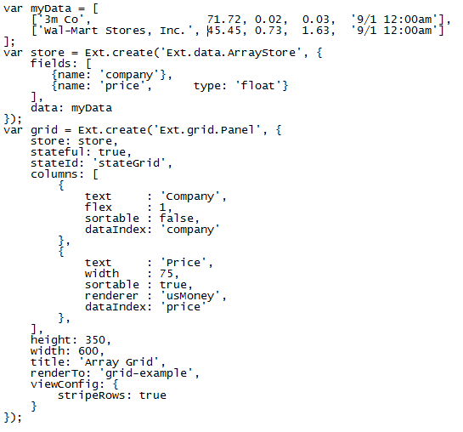
Grid Code

Slide 89
Charts
Pure javascript charting package
Extends the Ext.draw package
Works with SVG and VML, automatically using the best engine it can find on each browser
Full featured chart library
Pie, bar, stacked, line, etc
Scatter plots, gauges, live update, radar charts
Works using the same data sets as Grids
Define the axes
Define the series
Example:
http://dev.sencha.com/deploy/ext-4.0.0/examples/charts/FormDashboard.html

Slide 90
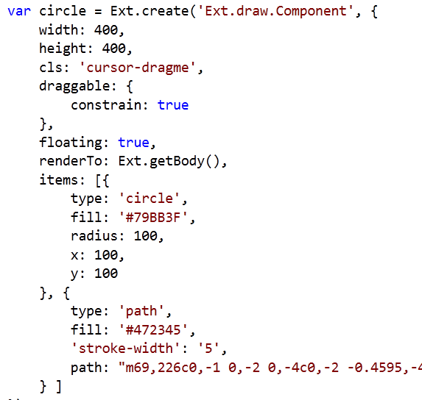
Draw Example

Slide 91
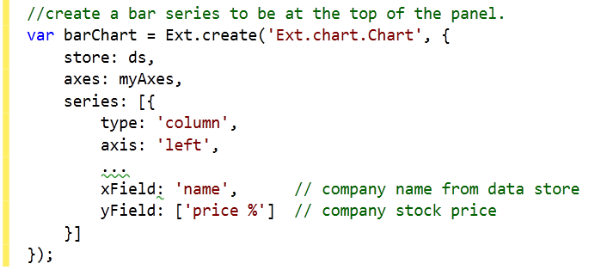
Charts example/code

Slide 92
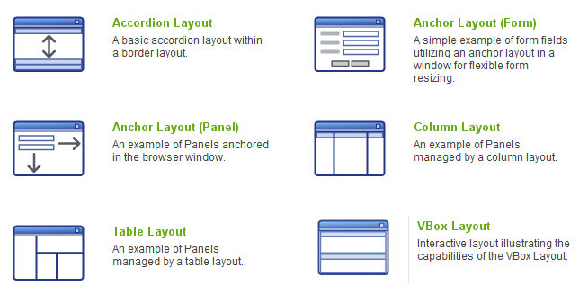
Layout Management

Slide 93
Column layout example
http://dev.sencha.com/deploy/ext-4.0.0/examples/layout/column.html

Slide 94
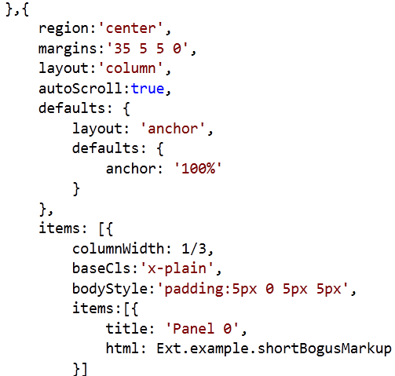
Column Layout Code

